Slide 1

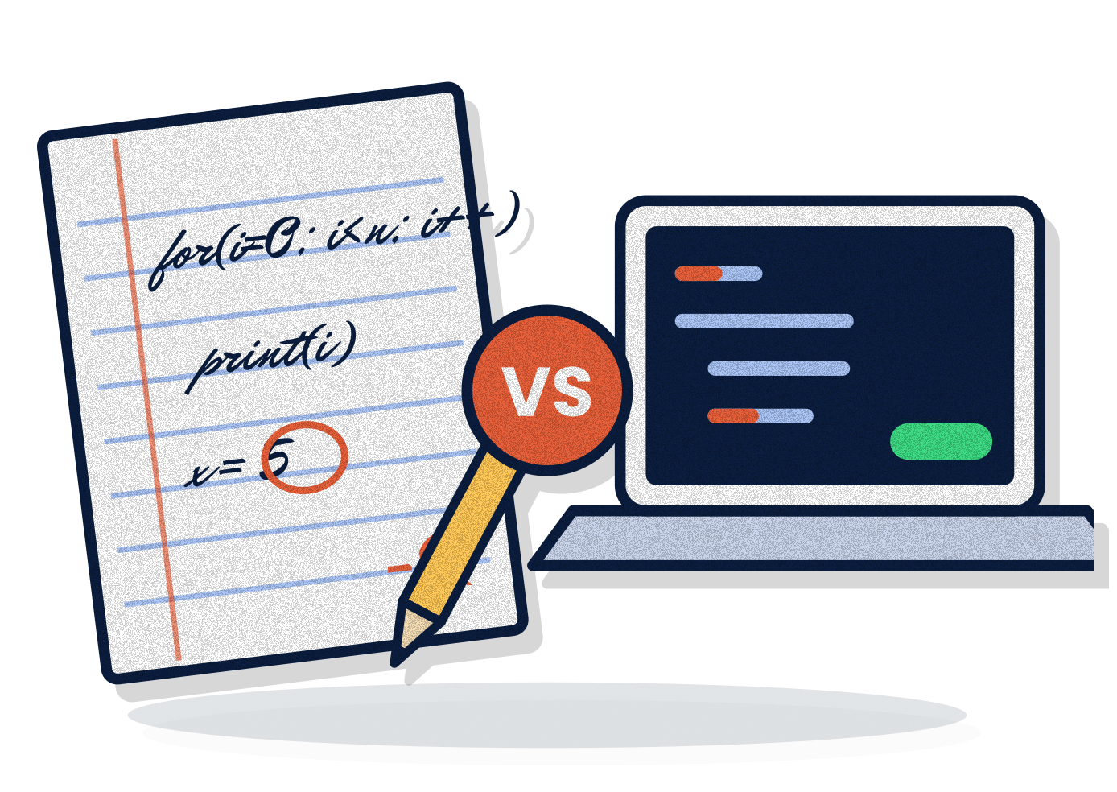

MUST · FIELD PRACTICAL TRAINING 2026
depriver.tech
Life in Uni
Real World
in Tech.
vs
What uni teaches vs what the real world in tech expects.
FPT edition
Privatus Cosmas
Software Engineer & Digital Innovator, Rohi Company Ltd · Founder, INCPRITECH
Scan to connect
Notes:
Walk in with energy. Smile. Wait for silence.
"Good morning everyone!" (If weak: "That sounds like people who've been waking up early for FPT! Again!")
"Today's topic is simple: Life in Uni vs Real World in Tech. What university teaches you, and what the real world in tech expects."

Slide 2


BEFORE ANYTHING ELSE
depriver.tech
You finished FPT.
Give yourselves
a round of applause!
travel · transport · supervisors... survived
LIFE IN UNI VS REAL WORLD IN TECH · WHAT YOU DO NOW SHAPES IT
@_depriver
Notes:
"Before anything else, give yourselves a round of applause, because you've finished your field practical training." (Clap with them.)
"Some of you travelled far, struggled with transport and money, had difficult supervisors. But you made it. Well done."

Slide 3
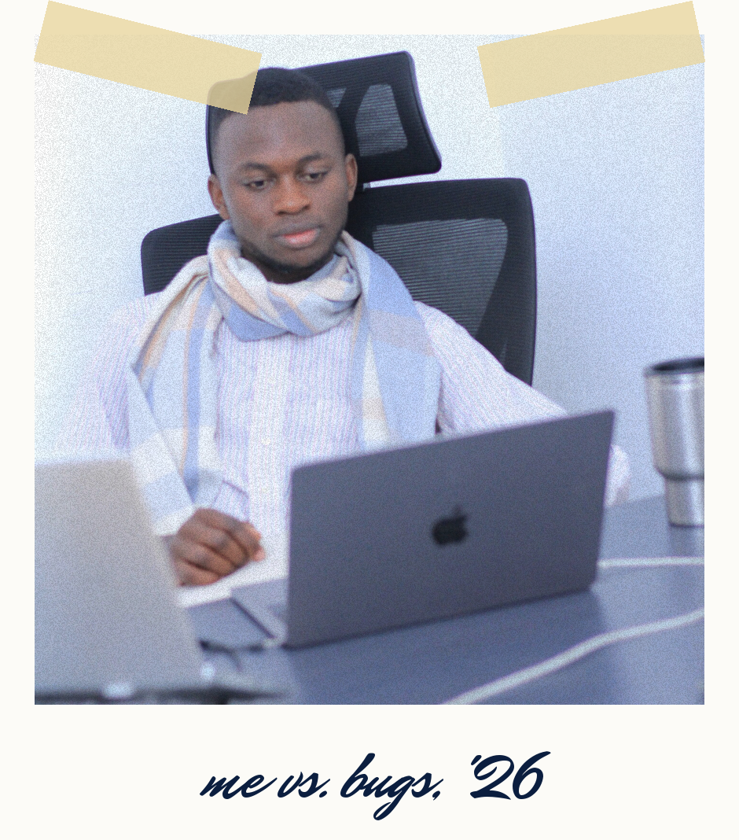

WHO'S THIS GUY?
depriver.tech
Privatus Cosmas
Software Engineer & Digital Innovator, Rohi Company Ltd
Founder, INCPRITECH
MUST alumnus · Diploma in Computer Science
First FPT at MUST in 2024. It shaped me.
your brother, not your boss
LIFE IN UNI VS REAL WORLD IN TECH · WHAT YOU DO NOW SHAPES IT
@_depriver
Notes:
"My name is Privatus Cosmas. I'm a Software Engineer and Digital Innovator at Rohi Company Limited, and the founder of a tech startup called INCPRITECH. And I did my first FPT right here at MUST, in 2024. That FPT shaped me. I've sat exactly where you're sitting."

Slide 4
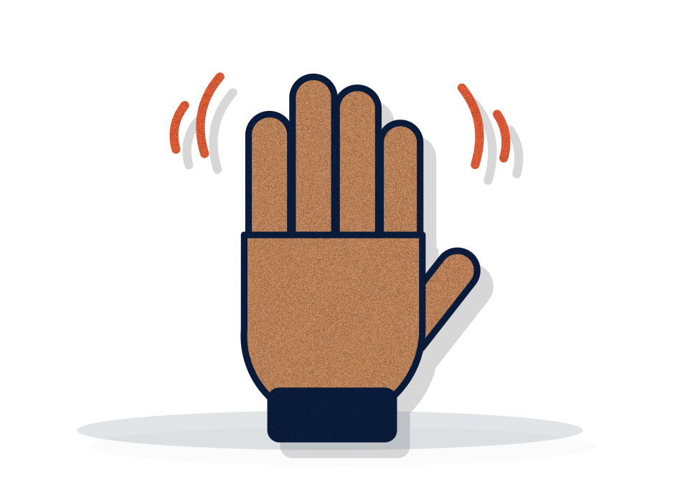

YOUR FPT
depriver.tech
You stepped out of uni life
and tasted real-world tech.
hands up if work surprised you
LIFE IN UNI VS REAL WORLD IN TECH · WHAT YOU DO NOW SHAPES IT
@_depriver
Notes:
"For the last few weeks you stepped out of life in uni, the lectures and the campus, and you tasted the real world in tech.
Hands up: who noticed that work is very different from what we learn in class?" (Hands.) "Keep your hands up if something at FPT surprised you."
"I felt the same in my first FPT. So today we'll play six rounds: Life in Uni vs Real World in Tech."

Slide 5

REAL WORLD
UNIVERSITY
Real World
in Tech.
Life in Uni
vs
what university teaches you
what the real world in tech expects
6 rounds
Notes:
"Life in Uni on this side. Real World in Tech on that side. Six rounds. For each one I'll show you the difference, and then one thing you can do while you're still a student."

Slide 6

ROUND 01 / 06
depriver.tech
Code on paper
vs code on screen.
LIFE IN UNI
REAL WORLD IN TECH
Java on paper in the exam. One missing ; and the marks are gone.
An editor, a linter, autocomplete. You run the code fifty times a day.
01
LIFE IN UNI VS REAL WORLD IN TECH · WHAT YOU DO NOW SHAPES IT
@_depriver
Notes:
Round 1: Code on paper vs. code on screen.
"At FPT, who wrote code or configured something on a real machine, and got errors? (Hands.) In class we write Java on paper, and one missing semicolon costs marks. At work you have an editor, a linter, autocomplete, and you run the code fifty times a day. The real skill is logic, and reading the error message."

Slide 7


ROUND 01 / 06
depriver.tech
Code on paper
vs code on screen.
LIFE IN UNI
REAL WORLD IN TECH
Java on paper in the exam. One missing ; and the marks are gone.
An editor, a linter, autocomplete. You run the code fifty times a day.
01
Somo
STILL IN SCHOOL? DO THIS
Type your paper code on a computer the same day.
Notes:
(Morph: the navy bar rises.) "Still in school? Do this: Paper code trained my logic, so school isn't useless. But type your paper code on a computer the same day. Mantiki kwanza, sintaksia baadaye."

Slide 8
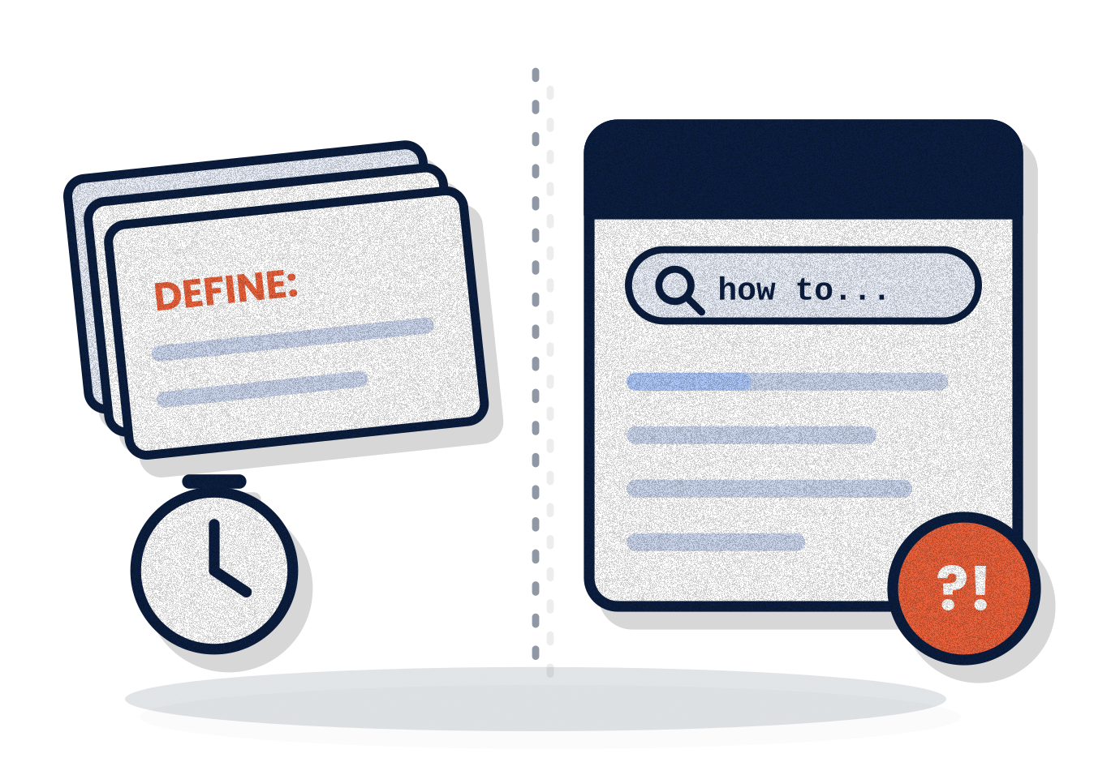
ROUND 02 / 06
depriver.tech
Memorise it
vs find it.
LIFE IN UNI
REAL WORLD IN TECH
Exams reward cramming definitions word for word.
Nobody memorises everything. Seniors search, read docs and ask all day.
02
LIFE IN UNI VS REAL WORLD IN TECH · WHAT YOU DO NOW SHAPES IT
@_depriver
Notes:
Round 2: Memorise it vs. find it.
"Did your supervisor know every command by heart? (Let them answer.) No. They searched, read the docs and asked colleagues. Exams reward cramming definitions word for word. At work nobody memorises everything."

Slide 9


ROUND 02 / 06
depriver.tech
Memorise it
vs find it.
LIFE IN UNI
REAL WORLD IN TECH
Exams reward cramming definitions word for word.
Nobody memorises everything. Seniors search, read docs and ask all day.
02
Somo
STILL IN SCHOOL? DO THIS
Practise reading official docs, not only notes.
Notes:
(Morph: the navy bar rises.) "Still in school? Do this: Practise reading official documentation, not only lecture notes. Hakuna anayekariri kila kitu."

Slide 10
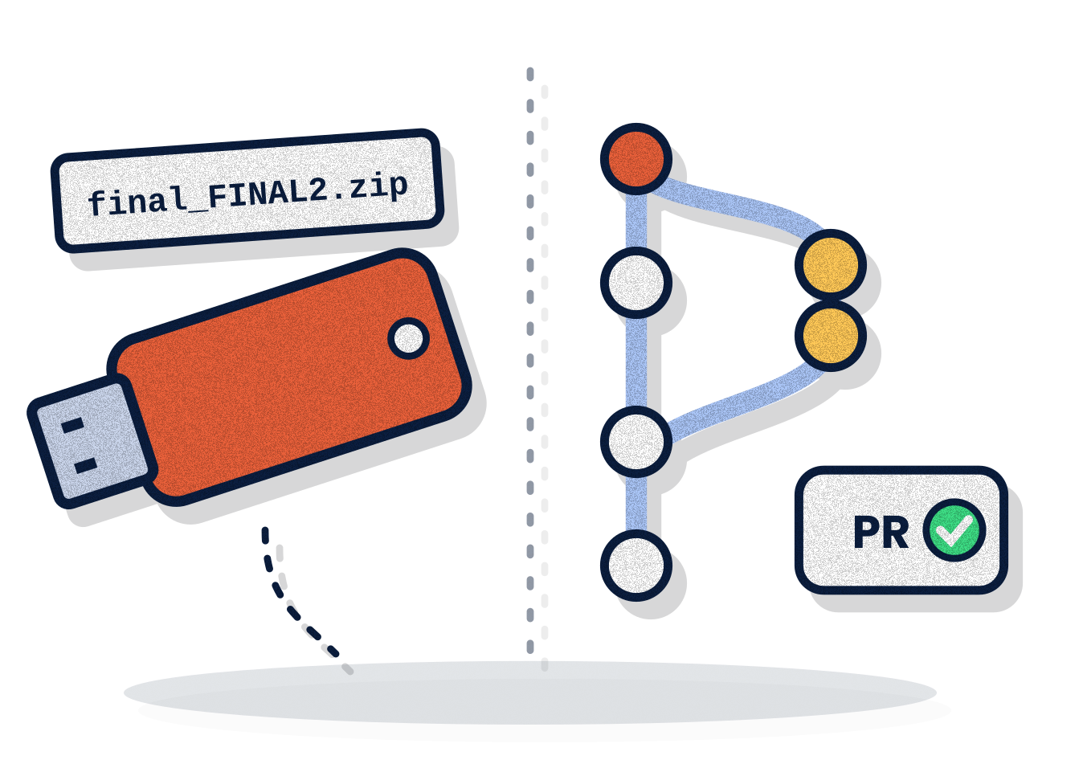
ROUND 03 / 06
depriver.tech
Group work
vs teamwork.
LIFE IN UNI
REAL WORLD IN TECH
One person does the whole group work. The rest just add their names.
Everyone ships. Git and code review show exactly who did what.
03
LIFE IN UNI VS REAL WORLD IN TECH · WHAT YOU DO NOW SHAPES IT
@_depriver
Notes:
Round 3: Group work vs. teamwork.
"Be honest: who has been in a group assignment where one person did everything and the rest just added their names? (Laughs, hands.) Then it travels on a flash drive as final_FINAL2.zip. At FPT you saw real teams: everyone ships, and Git and code review show exactly who did what."

Slide 11


ROUND 03 / 06
depriver.tech
Group work
vs teamwork.
LIFE IN UNI
REAL WORLD IN TECH
One person does the whole group work. The rest just add their names.
Everyone ships. Git and code review show exactly who did what.
03
Somo
STILL IN SCHOOL? DO THIS
Do your part, and put it on GitHub from day one.
Notes:
(Morph: the navy bar rises.) "Still in school? Do this: Do your part, and put it on GitHub from day one. Kazi ya kikundi, si ya mtu mmoja."

Slide 12
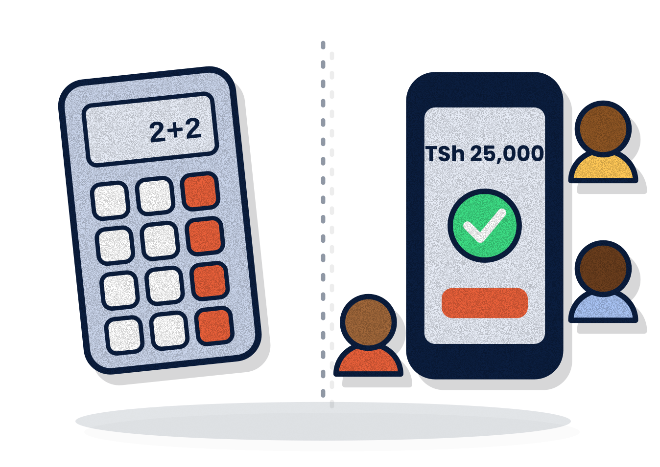
ROUND 04 / 06
depriver.tech
Toy projects
vs real users.
LIFE IN UNI
REAL WORLD IN TECH
A calculator. A student system. Your lecturer is the only user.
Real people, real money, slow networks and every edge case you forgot.
04
LIFE IN UNI VS REAL WORLD IN TECH · WHAT YOU DO NOW SHAPES IT
@_depriver
Notes:
Round 4: Toy projects vs. real users.
"In class we build a calculator or a student management system, and the only user is the lecturer. At FPT you saw real users: a shop, a hospital, an office. Real people, real money, slow networks, and every edge case you forgot. When it breaks, people call."

Slide 13


ROUND 04 / 06
depriver.tech
Toy projects
vs real users.
LIFE IN UNI
REAL WORLD IN TECH
A calculator. A student system. Your lecturer is the only user.
Real people, real money, slow networks and every edge case you forgot.
04
Somo
STILL IN SCHOOL? DO THIS
Build one thing a real person uses, every semester.
Notes:
(Morph: the navy bar rises.) "Still in school? Do this: Build one thing a real person uses, every semester. Mteja hasomi code yako, the customer never reads your code."

Slide 14
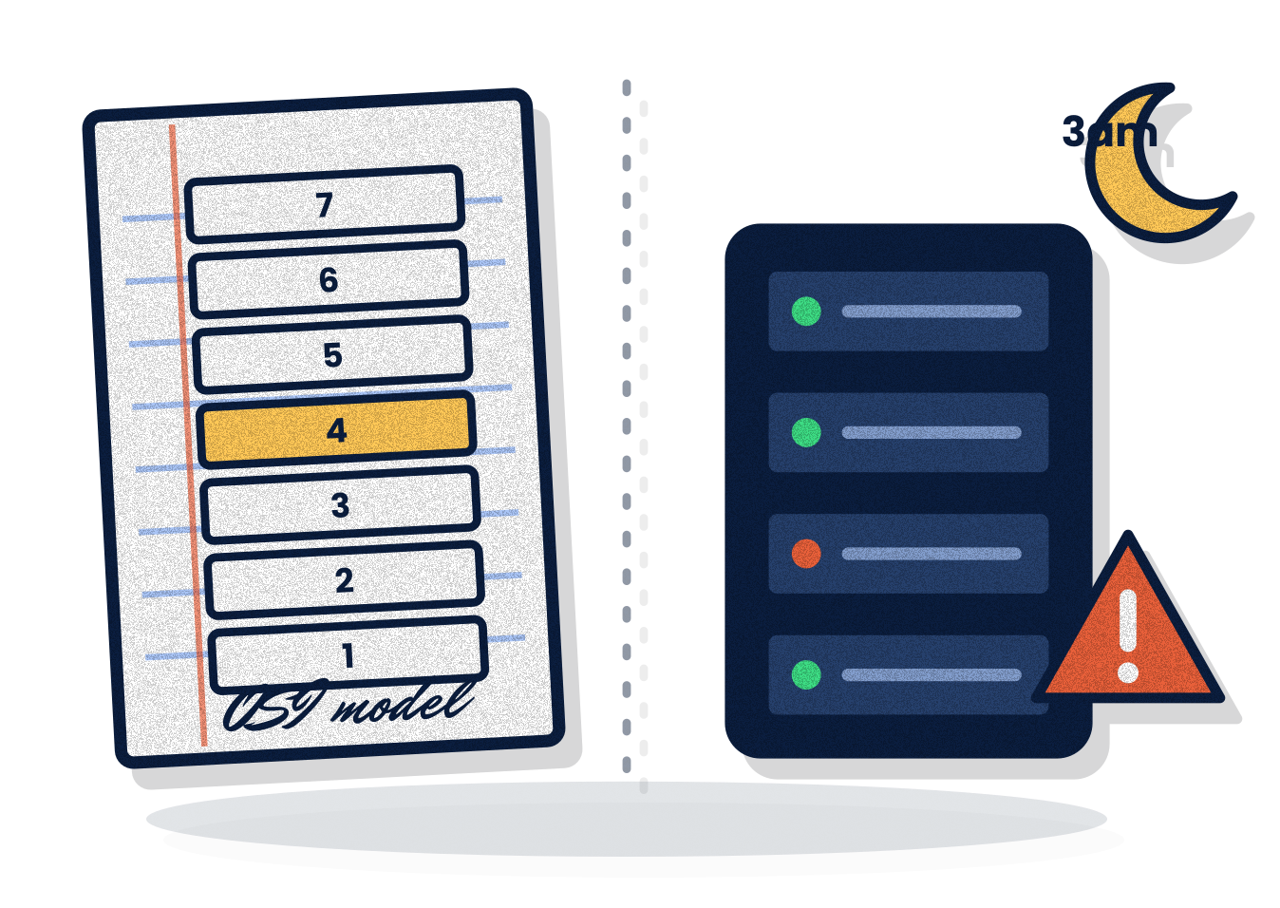
ROUND 05 / 06
depriver.tech
Diagrams
vs production.
LIFE IN UNI
REAL WORLD IN TECH
Draw the OSI model and the waterfall SDLC for marks.
Servers, domains, deploys, and something breaking at 3 a.m.
05
LIFE IN UNI VS REAL WORLD IN TECH · WHAT YOU DO NOW SHAPES IT
@_depriver
Notes:
Round 5: Diagrams vs. production.
"At school we draw the OSI model and the waterfall SDLC for marks. At FPT, did anyone see a network go down or a system break? (Hands.) That's production: servers, domains, deploys, and something breaking at 3 a.m. 'It works on my machine' is not done."

Slide 15


ROUND 05 / 06
depriver.tech
Diagrams
vs production.
LIFE IN UNI
REAL WORLD IN TECH
Draw the OSI model and the waterfall SDLC for marks.
Servers, domains, deploys, and something breaking at 3 a.m.
05
Somo
STILL IN SCHOOL? DO THIS
Deploy your project online, even on a free tier.
Notes:
(Morph: the navy bar rises.) "Still in school? Do this: Deploy your project online, even on a free tier. Kwangu inafanya kazi, haitoshi."

Slide 16

ROUND 06 / 06
depriver.tech
Grades
vs GitHub.
LIFE IN UNI
REAL WORLD IN TECH
GPA and certificates are the scoreboard.
“Show me what you've built.” I got hired while still a student.
06
LIFE IN UNI VS REAL WORLD IN TECH · WHAT YOU DO NOW SHAPES IT
@_depriver
Notes:
Round 6: Grades vs. GitHub.
"Did anyone at FPT ask for your GPA? (Pause.) No. They asked: can you do this? At school GPA and certificates are the scoreboard. At work the question is 'show me what you've built'. That's how I got hired while I was still a student."

Slide 17


ROUND 06 / 06
depriver.tech
Grades
vs GitHub.
LIFE IN UNI
REAL WORLD IN TECH
GPA and certificates are the scoreboard.
“Show me what you've built.” I got hired while still a student.
06
Somo
STILL IN SCHOOL? DO THIS
Keep three projects you can demo in two minutes.
Notes:
(Morph: the navy bar rises.) "Still in school? Do this: Keep three projects you can demo in two minutes. Vitendo vinaongea zaidi, actions speak louder."

Slide 18

02
PART TWO · BACK TO CLASS
Learn it in class.
Prove it in projects.
Notes:
"So when you go back to class, you're not the same person who left. You've seen the real world in tech. Now let's use it."

Slide 19

YOUR TURN
depriver.tech
?
What did FPT teach you
that class never did?
LIFE IN UNI VS REAL WORLD IN TECH · WHAT YOU DO NOW SHAPES IT
@_depriver
Notes:
"Your turn. What did FPT teach you that class never did?" Take 2–3 answers. React with energy.
(Share one honest line about your own first FPT at MUST in 2024: one thing it taught you.)

Slide 20

BEFORE YOU LEAVE · 4 THINGS
depriver.tech
Finish strong.
01
Logbook & report
02
Recommendation letter
show the skill, not the activity
thank your supervisor, then ask
03
Keep your contacts
04
Collect evidence
your network is your net worth
photos, screenshots, notes
Not: “I observed the network”
Yes: “I configured 3 switches”
LIFE IN UNI VS REAL WORLD IN TECH · WHAT YOU DO NOW SHAPES IT
@_depriver
Notes:
"Your FPT isn't finished until you do four things:
1. Complete your logbook properly. Not 'I observed the network.' Write 'I configured 3 switches and fixed IP conflicts.'
2. Thank your supervisor and ask for a recommendation letter.
3. Keep your contacts. Your network is your net worth.
4. Collect evidence: photos, screenshots, notes, with permission.
How many have asked for a recommendation letter? That's your homework this week!"

Slide 21

STILL IN SCHOOL? START NOW
depriver.tech
Start now.
01
Type up your paper code
02
Ship a real project
same day
every semester
03
Live on GitHub
04
Use AI as a tutor
commit, push, repeat
not a copy machine
05
Treat every project like real work
06
Respect the fundamentals
real users, real deadlines
logic, data structures, maths
LIFE IN UNI VS REAL WORLD IN TECH · WHAT YOU DO NOW SHAPES IT
@_depriver
Notes:
"School isn't useless. Paper code trains your logic, and the fundamentals matter. Just don't stop there. Six habits to start now, before you graduate:" (read them)
"Learn it in class. Prove it in projects."

Slide 22

03
PART THREE · MONEY
Make money
the right way.
Notes:
"Many of you are thinking: 'Privatus, the real world sounds good, but I need money now.' I understand, I was there too. Let's talk money."

Slide 23
USE YOUR STUDENT STATUS
depriver.tech
Your student email is
worth millions.
expires when you graduate
GitHub Student Pack
Huawei ICT Academy
Cisco NetAcad
Azure for Students
Microsoft 365
AWS Educate
Microsoft Learn
ALX Africa
Figma · Notion
YouTube / Spotify Student*
*where available
LIFE IN UNI VS REAL WORLD IN TECH · WHAT YOU DO NOW SHAPES IT
@_depriver
Notes:
"Who knows your student ID and university email are worth millions of shillings?" (Confused faces.)
"Big tech gives students free tools, courses and certifications. Most never use them, then graduate and lose access.
Activate your university email, keep a photo of your student ID, look for 'Students' or 'Education' on each site. These expire when you graduate. Use them now."

Slide 24

USE YOUR STUDENT STATUS · HOW TO CLAIM
depriver.tech
Claim them
this week.
expires when you graduate
01
02
03
Activate your uni email
Photo of your student ID
Look for “Students”
most benefits need it
clear and ready to upload
or “Education” on each site
LIFE IN UNI VS REAL WORLD IN TECH · WHAT YOU DO NOW SHAPES IT
@_depriver
Notes:
"How to claim them: activate your university email, most benefits need it. Keep a clear photo of your student ID. Go to each website and look for 'Students' or 'Education'.
Remember: these benefits expire when you graduate. Every free course and certificate you earn now goes straight onto your CV."

Slide 25
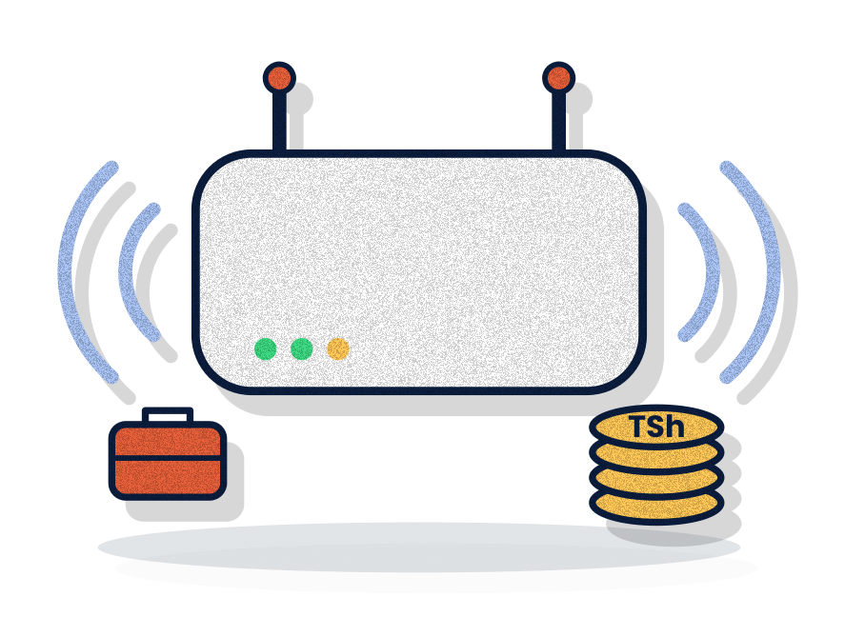
TECH GIGS & FREELANCING
depriver.tech
A gig pays you twice:
money + experience.
Repair & software installation
IT support & network setup
Websites for local businesses
Design & social media
Upwork · Fiverr (once you have work to show)
pay to get a job? = SCAM
LIFE IN UNI VS REAL WORLD IN TECH · WHAT YOU DO NOW SHAPES IT
@_depriver
Notes:
"As a tech student you can already earn with your skills, and every shilling builds your career: repair and installation, IT support and network setup for shops, schools, pharmacies; websites for local businesses; design and social media; later Upwork and Fiverr.
Start local. Do the first jobs very well. Keep every job in your portfolio. Be reliable. And if someone asks YOU to pay for a job, it's a scam."

Slide 26

TECH GIGS · HOW TO WIN THEM
depriver.tech
Skills get the gig.
Reliability keeps it.
01
Start local
02
Do the first jobs very well
friends, family, shops near campus
your reputation is your advert
03
Keep a portfolio
04
Be reliable
screenshots, photos, thank-yous
on time, every time, and talk
pay to get a job? = SCAM
LIFE IN UNI VS REAL WORLD IN TECH · WHAT YOU DO NOW SHAPES IT
@_depriver
Notes:
"My advice for freelancing: start local, your first clients are around you. Do the first jobs very well, even if they're cheap: your reputation is your advertisement. Keep every job in your portfolio. Be reliable: deliver on time and communicate. Many people have skills, few are reliable.
And if someone asks YOU to pay before you get a job, it's a scam."

Slide 27
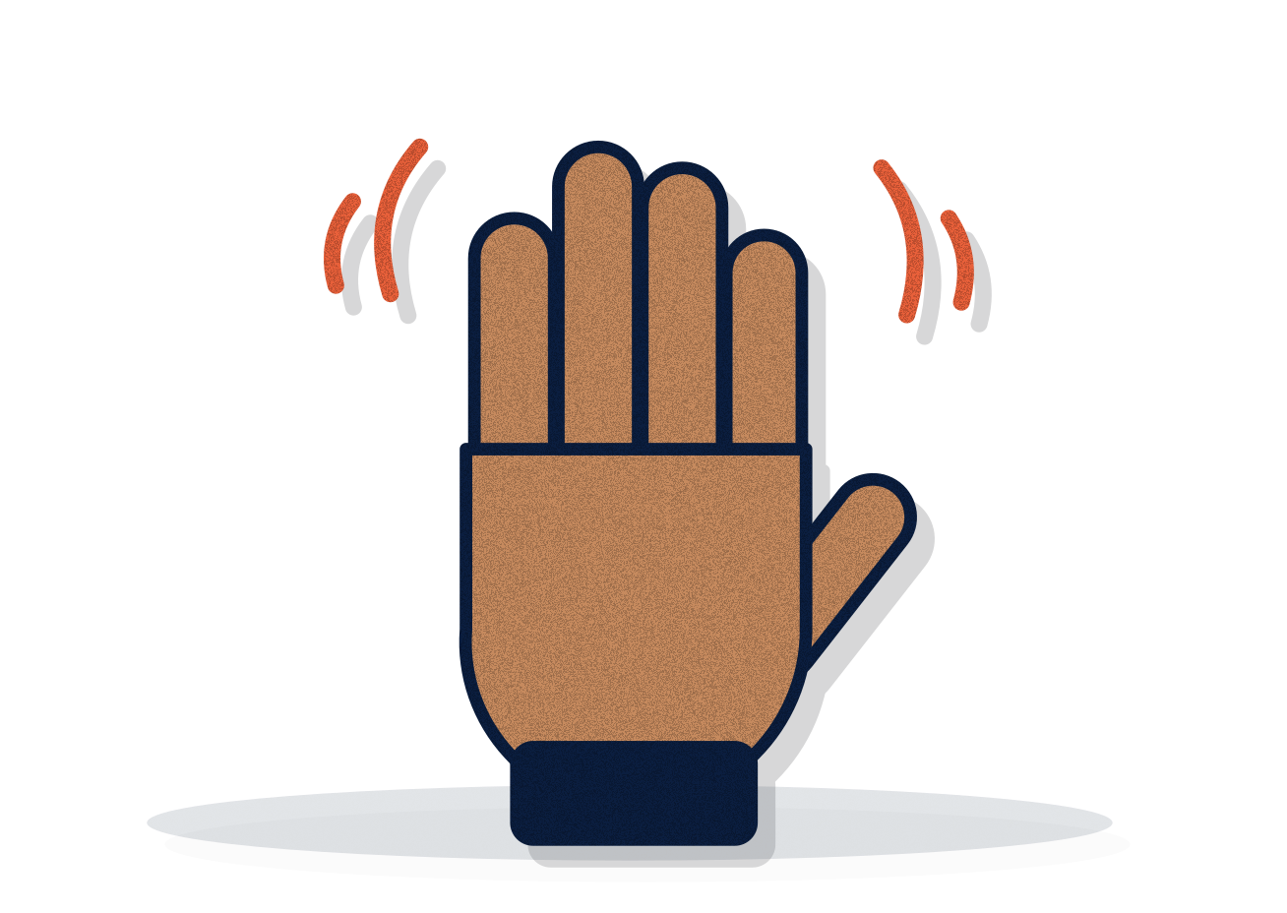
A BROTHERLY WARNING
depriver.tech
Who knows someone
who bets?
no judging, I've been there
LIFE IN UNI VS REAL WORLD IN TECH · WHAT YOU DO NOW SHAPES IT
@_depriver
Notes:
Talk like a big brother, not a preacher.
"Be honest: how many of you know someone who bets?" (Many hands.)
"I'm not here to judge anyone. I've been in that circle myself." (Add your own one or two honest lines here.)

Slide 28
A BROTHERLY WARNING
depriver.tech
Betting. Forex. Crypto.
Know the truth.
red flags
Betting
Forex “mentors”
“Double your money”
They make billions because most people lose.
If he makes millions trading, why does he need your 50k?
Guaranteed profit is almost always a scam.
That one win is the trap.
Gambling with a nicer name.
Learn the tech, keep your fees.
LIFE IN UNI VS REAL WORLD IN TECH · WHAT YOU DO NOW SHAPES IT
@_depriver
Notes:
"Betting: companies make billions because most people lose. That one win is the trap. I've seen students bet their boom, fees, food money.
Forex without knowledge: if that Instagram mentor makes millions trading, why does he need your 50,000 for a class? Without deep knowledge and money you can afford to lose, it's gambling with a nicer name.
Crypto & 'double your money': understand the tech, sure. But fees into TikTok coins or doubling groups is how students lose everything. Guaranteed profit is almost always a scam."

Slide 29

USICHEZE NA KESHO YAKO
depriver.tech
Betting asks:
“How do I get money fast?”
Skills ask:
“How do I become valuable?”
save 10% of everything
LIFE IN UNI VS REAL WORLD IN TECH · WHAT YOU DO NOW SHAPES IT
@_depriver
Notes:
"My simple advice: don't gamble with money you need to live. As a student, that's all of it. Invest in yourself first. Save something, even 10%. Learn first, invest later.
Betting asks: how can I get money fast? Skills ask: how can I become valuable? Choose value. Money follows value."

Slide 30
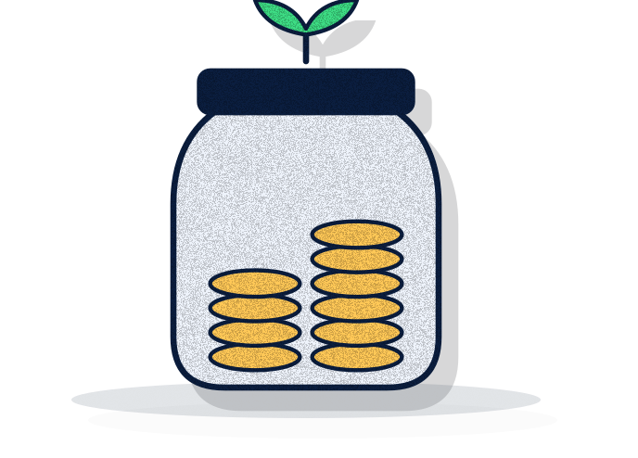
MY SIMPLE MONEY RULES
depriver.tech
Invest in yourself
first.
01
Never bet money you need
02
Invest in yourself
as a student, that's all of it
a course, a laptop, a skill
03
Save 10% of everything
04
Learn first, invest later
small savings build discipline
stable income + real knowledge
LIFE IN UNI VS REAL WORLD IN TECH · WHAT YOU DO NOW SHAPES IT
@_depriver
Notes:
"My simple advice as your brother: don't gamble with money you need to live. As a student, that's all your money. Invest in yourself first: a course, a laptop, a skill. That's the investment with the best return. Earn through your skills. Save something, even 10% of everything you earn. Learn first, invest later."

Slide 31

YOUR TURN
depriver.tech
?
Ask me
anything.
LIFE IN UNI VS REAL WORLD IN TECH · WHAT YOU DO NOW SHAPES IT
@_depriver
Notes:
"I've talked a lot. Now it's your turn. Ask me anything: school, jobs, business, tech, life."
Take one or two, then: "I'll stay after for more."
If nobody asks: "Who here wants to start their own business one day?"

Slide 32


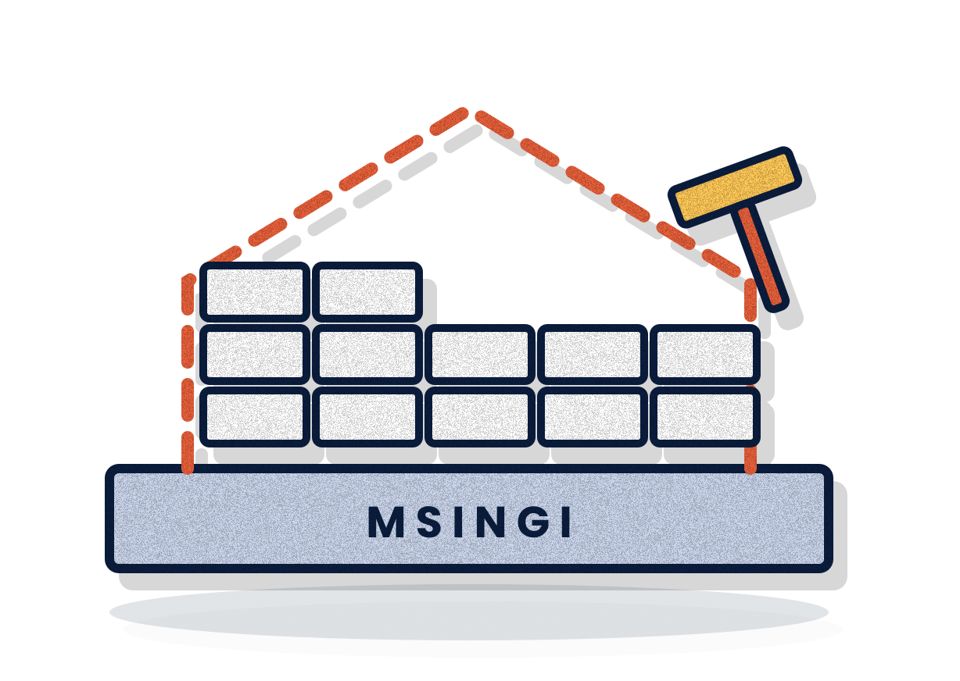
REMEMBER THIS
depriver.tech
School lays the foundation. You build the house.
LIFE IN UNI VS REAL WORLD IN TECH · WHAT YOU DO NOW SHAPES IT
@_depriver
Notes:
"Let me leave you with this. Shule inakupa msingi, nyumba unajenga wewe. School lays the foundation. You build the house.
Life in uni gives you the foundation. The real world in tech is where you build. And you don't have to wait for graduation to start building."

Slide 33

ONE LAST TIME, TOGETHER
Your starting point is
not your destination.
What you do now
shapes it.
Scan to connect
depriver.tech/contact
PHONE · WHATSAPP
INSTAGRAM
GITHUB
WEBSITE
+255 752 747 681
@_depriver
Stark-Priver
depriver.tech
Notes:
"Your FPT is ending, but your journey is just beginning. Your past brought you here, but it doesn't decide your future. Your daily choices do.
One day I want to come back and hear YOUR stories. Maybe one of you will stand here in my place.
Let's say it together:
Your starting point... → is not your destination!
What you do now... → shapes your destination!
Thank you very much, and God bless you all."
Stay for photos. Share LinkedIn and depriver.tech.

